Slide 1
Data Analysis Project
Framingham Heart Study

Slide 2



Gbenga Joshua Afolabi Delta state-Nigeria
B.sc, University of Benin, Nigeria
Data Analyst, MTN Nigeria.
Data Science Bootcamp (Paid-Track), DataGenZ Africa

Slide 3
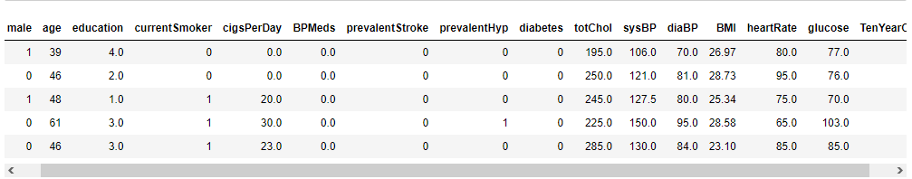



Project Title Exploratory Data Analysis on the Identification of Risk Factor of Heart Disease
Downloaded The Framingham Heart Study dataset from kaggle website.
(Mention total rows, columns and file size e.g.) Explored a total of 4240 rows and 16 columns of heart disease data with file size of 530.1kb.
Some key factors affecting the heart disease include: Smoking, Cholesterol level, Obesity, Lack of regular exercise, Diabetes, etc

Slide 4
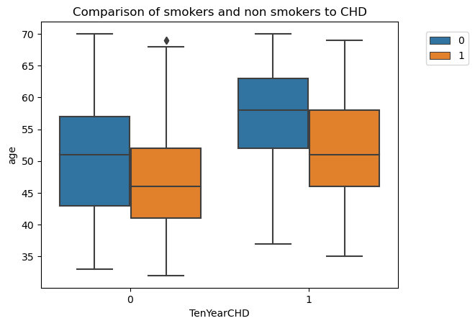
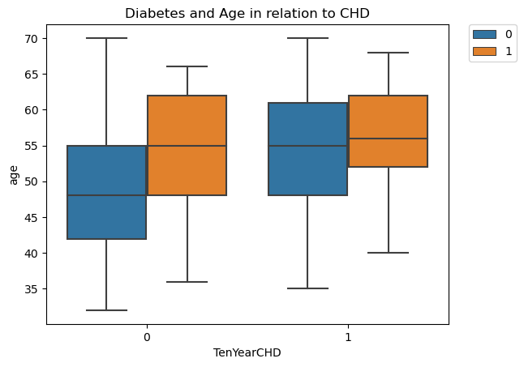
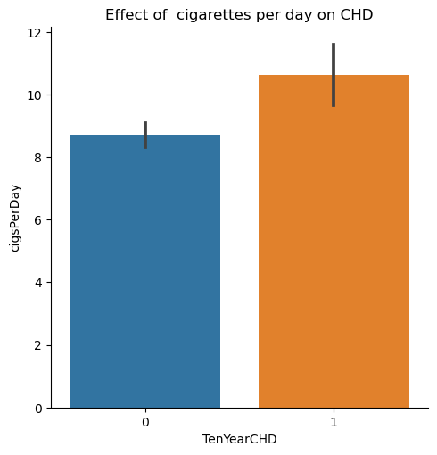
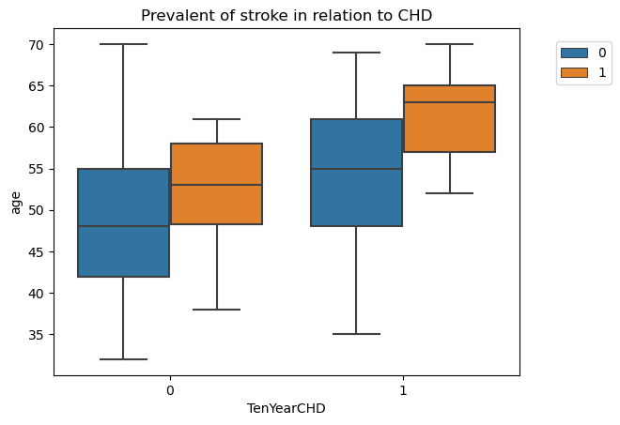
Analysis of Framingham Heart Study data 4240+ rows, 16+ Columns analyzed with Pandas & Seaborn

